Slide 1
Camera Calibration: Workhome 2
Israel Chaparro
Alvaro Rojas

Slide 2
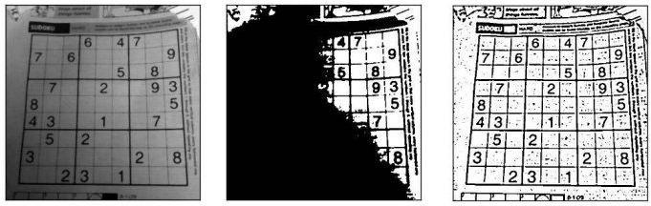
Adaptive thresholding
Thresholding algorithms that consider spatial lighting

Slide 3
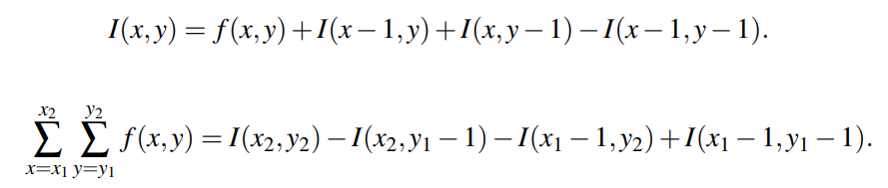
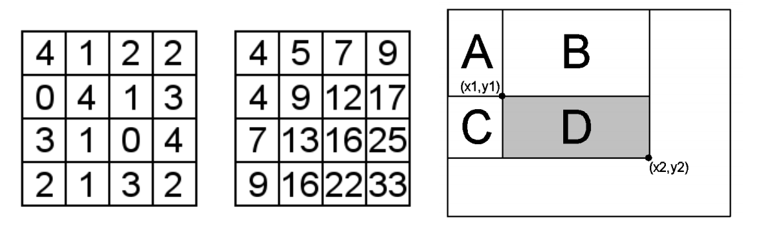
Integral Threshold

Slide 4
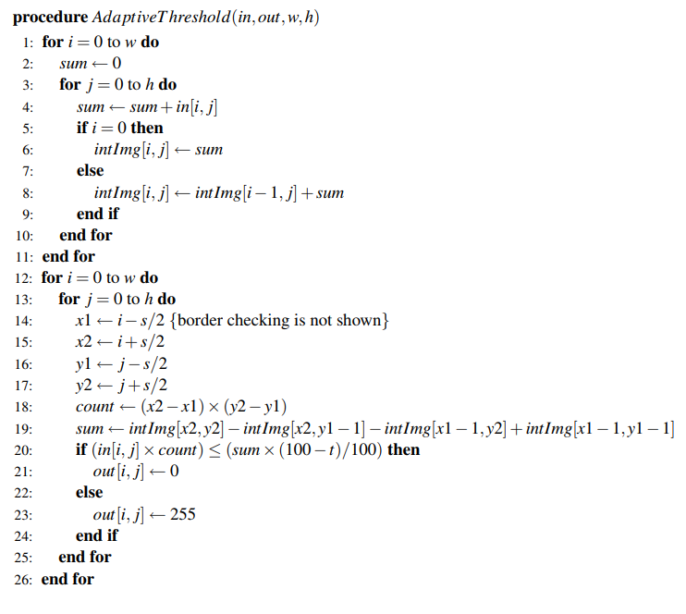
Integral Threshold

Slide 5
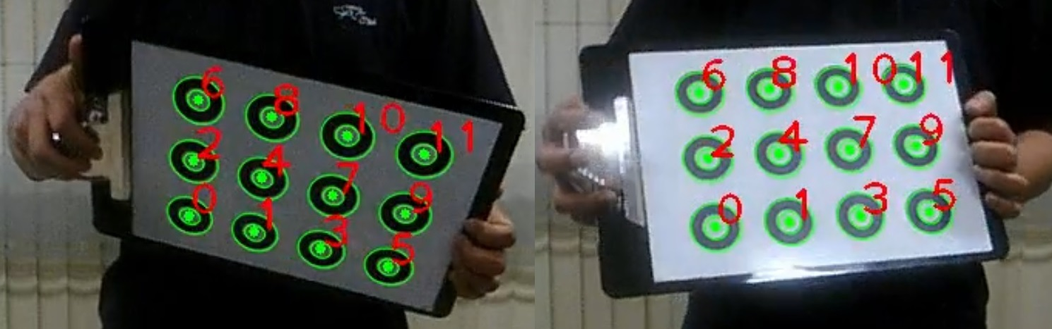
Integral Threshold

Slide 6
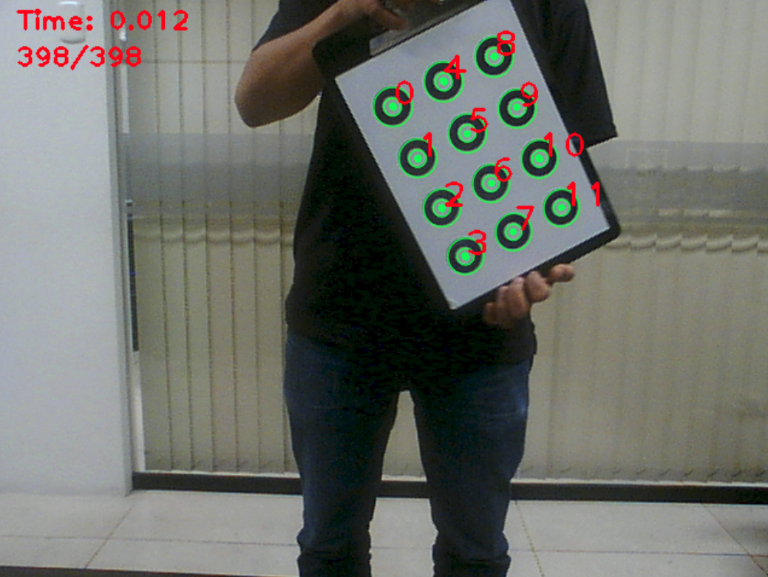
Pipeline of Pre-processing
rgb2gray
gaussianBlur
Integral
Threshold
erode+dilate
find rectangle, ellipse, center
Delete False Positives
Filter by Hierarchy
findcontours
Find the max_radious
Match & Track
Data Compensate

Slide 7
Filter by Hierarchy & Delete false positives
hierarchy[Next,Previous,First_Child,Parent]
Delete the contours.size()<24 || contours.size()>256 (maintain the hierarchy table).
Delete the First_Child==-1 & Parent==-1.

Slide 8
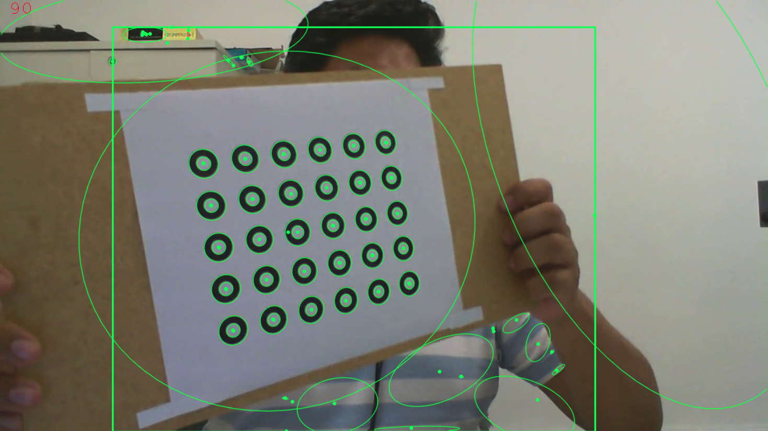
Filter by Hierarchy

Slide 9
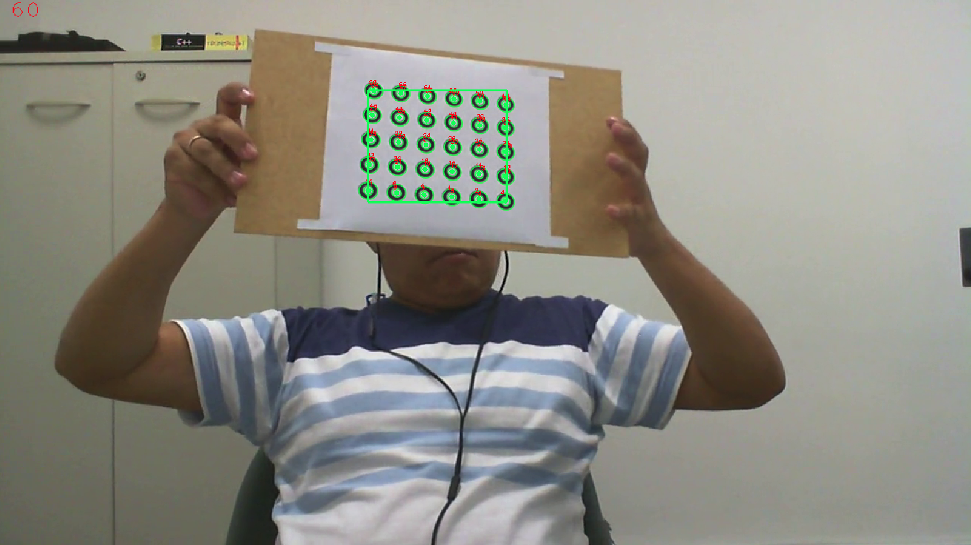
Filter by Hierarchy & Delete false positives

Slide 10
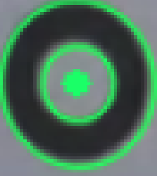
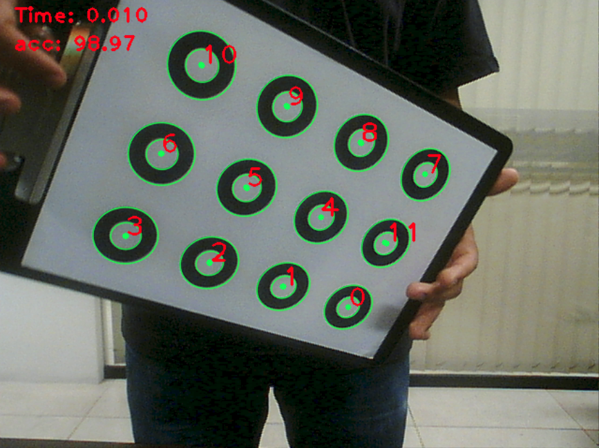
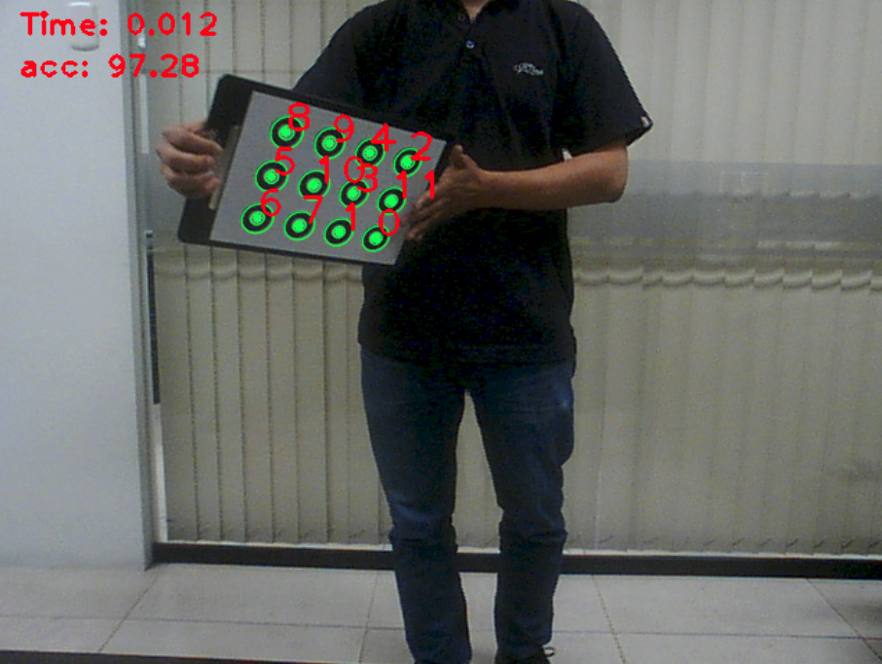
Find the max_radious
Objetive:
Use for center matching.
Utilily:
When the image is very close or far away.

Slide 11
Match & Track
Data compensate
1.- Find a double ellipse.
2.- Match by max_radious.
3.- Calc mean_center.
4.- Search in olds double ellipses and match by max_radious and update center.
5.- Save the unmatched.
6.- Delete the double ellipse.
1.- if don’t exists old double ellipses, use the unmatcheds.
2.- if loss > 2, use all the new double ellipses.
3.- if old double ellipses < 12, add the unmatcheds. (re-tracking)

Slide 12
RESULTS

Slide 13
